Slide 1
Etudiant 1
Analyse projet

Slide 2
SOMMAIRE
USE CASE DIAGRAM
CLASS DIAGRAM
SEQUENCE DIAGRAM

Slide 3
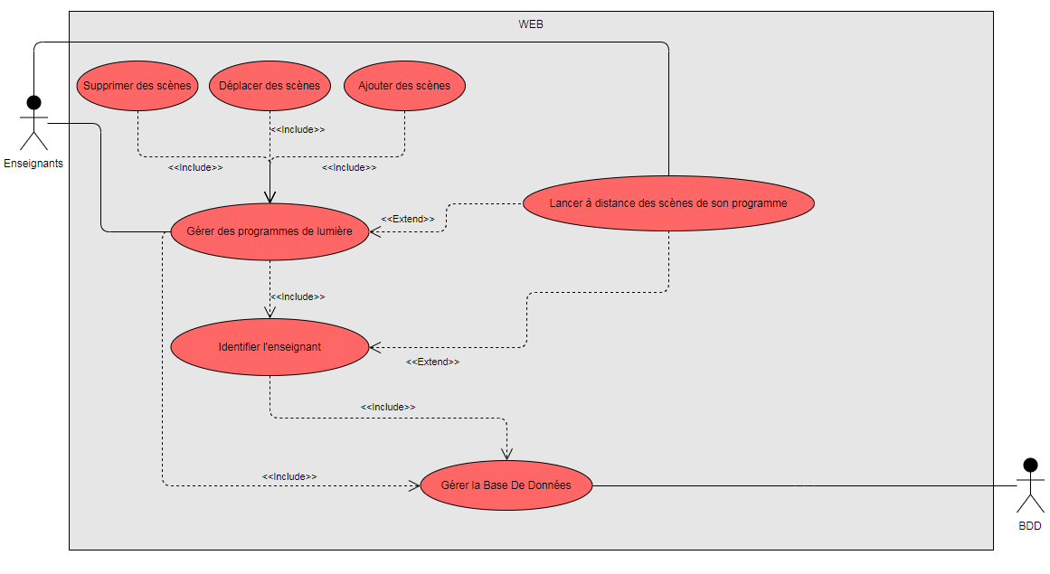
USE CASE DIAGRAM

